Slide 1
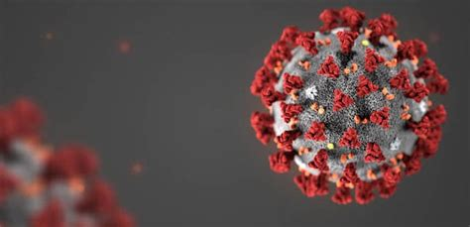
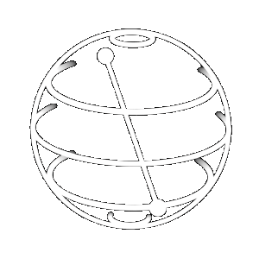
QUANTUM
MEETS
COVID-19
Simulating SARS-CoV-2 transmission
by Contact Tracing
of Entangled Individuals
Aaron Margolis
Jhon Alejandro Montanez Barrera
Neil Patel
Alden Grover

Slide 2
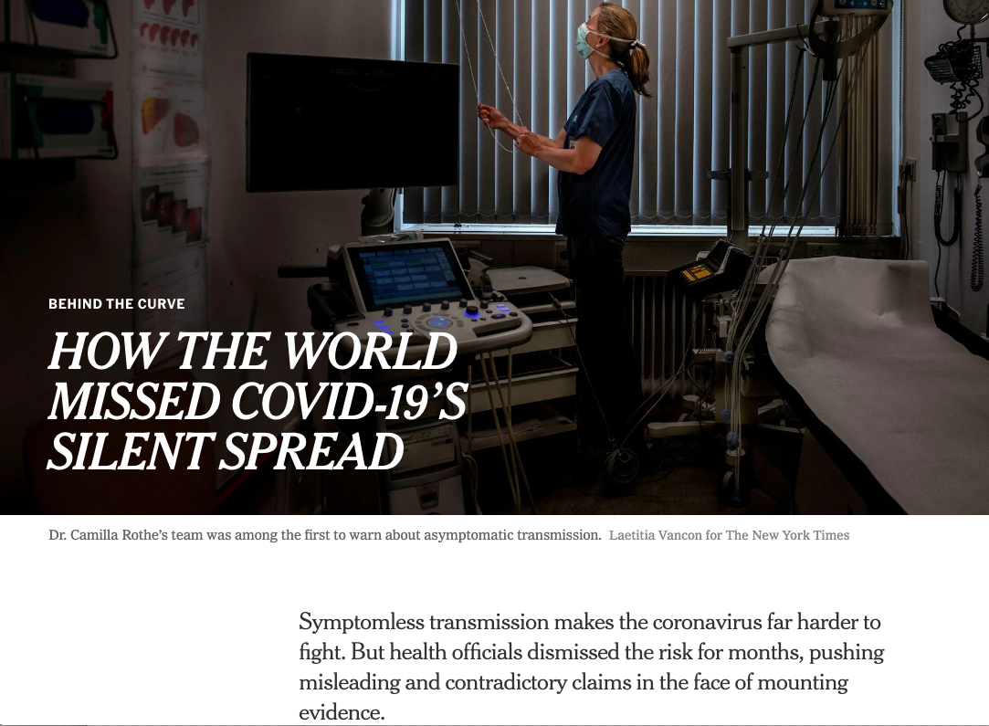
Problem: Can Quantum Computing help identify asymptomatic carriers?
Novel SARS-CoV-2 virus
Over 500k Deaths as of June 30
Asymptomatic carriers account for almost half of all SARS-CoV-2 cases. [1]
Countries are adopting extensive quarantine, contact tracing and testing measures
If we can prioritize testing based on digital contact tracing, we can better identify asymptomatic carriers
[1] https://www.acpjournals.org/doi/10.7326/M20-3012
[2] https://www.nytimes.com/2020/06/27/world/europe/coronavirus-spread-asymptomatic.html

Slide 3

Contact Tracing
Contact Tracing gather informations on movement patterns
spider web of transmissions based on digital data and geospatially correlated events
can be utilized to follow a pathogen like coronavirus, as it spreads from person to person
SARS-CoV-2 data currently not available for public use [3]
[3] https://www.cdc.gov/coronavirus/2019-ncov/php/open-america/contact-tracing-resources.html

Slide 4
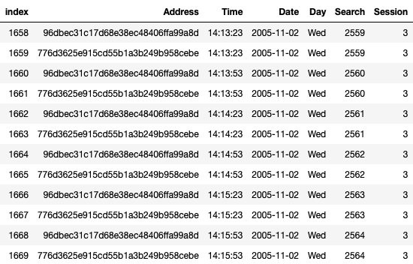
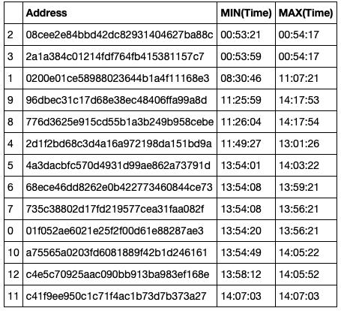
Network Generation
Utilized 2005 Singapore Dataset for real contact data
Very similar to data for SARS-Cov-2 digital contact tracers
Injected random seeds to initiate virus
Randomly simulated growth of simulated virus to propagate
Raw Data:
Converted Data:
[4] http://crawdad.org/nus/bluetooth/20070903/
A Community Resource for Archiving Wireless Data at Dartmouth

Slide 5
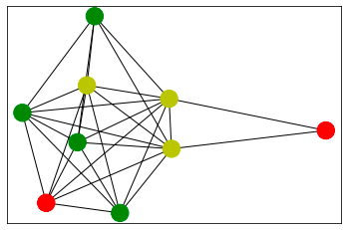
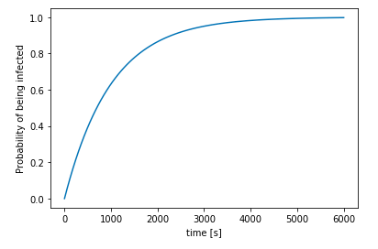
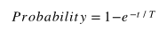
2005-11-02 Example Simulation Network
Infection Spread as a function of time together
Network Overview
Green nodes are not infected
Red nodes are sources of infection
X marks tested nodes
Yellow nodes were infected by source nodes
[5] T similar to CDC restaurant study (75% infection rate of Table B after 53 minutes next to infected carrier and 30% infection for Table C after 73 minutes) https://wwwnc.cdc.gov/eid/article/26/7/20-0764_article

Slide 6
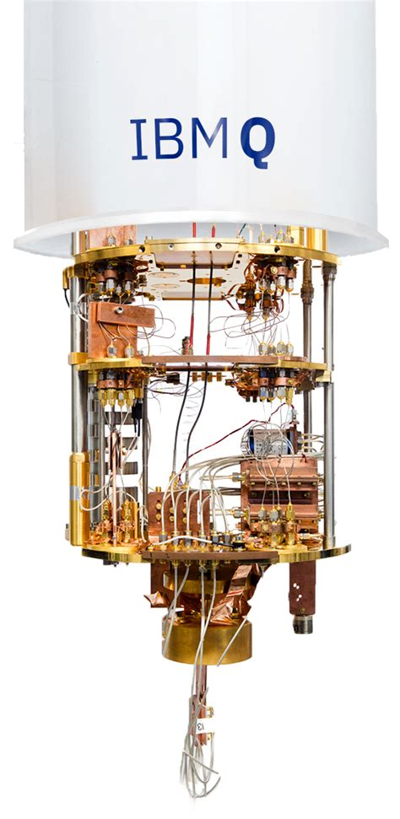
Quantum Implementation
Each individual is encoded as a single qubit
Interaction of Individuals is simulated by entangled qubits
This results in a higher dimensional Hilbert Space
Currently, quantum representation can model small communities
With increase in qubit number, larger populations can be modeled
Another approach is to map spread of virus on a higher level of abstraction (e.g. each node/qubit represents a state or county)
Application of quantum simulation might suggests algorithmic boost

Slide 7
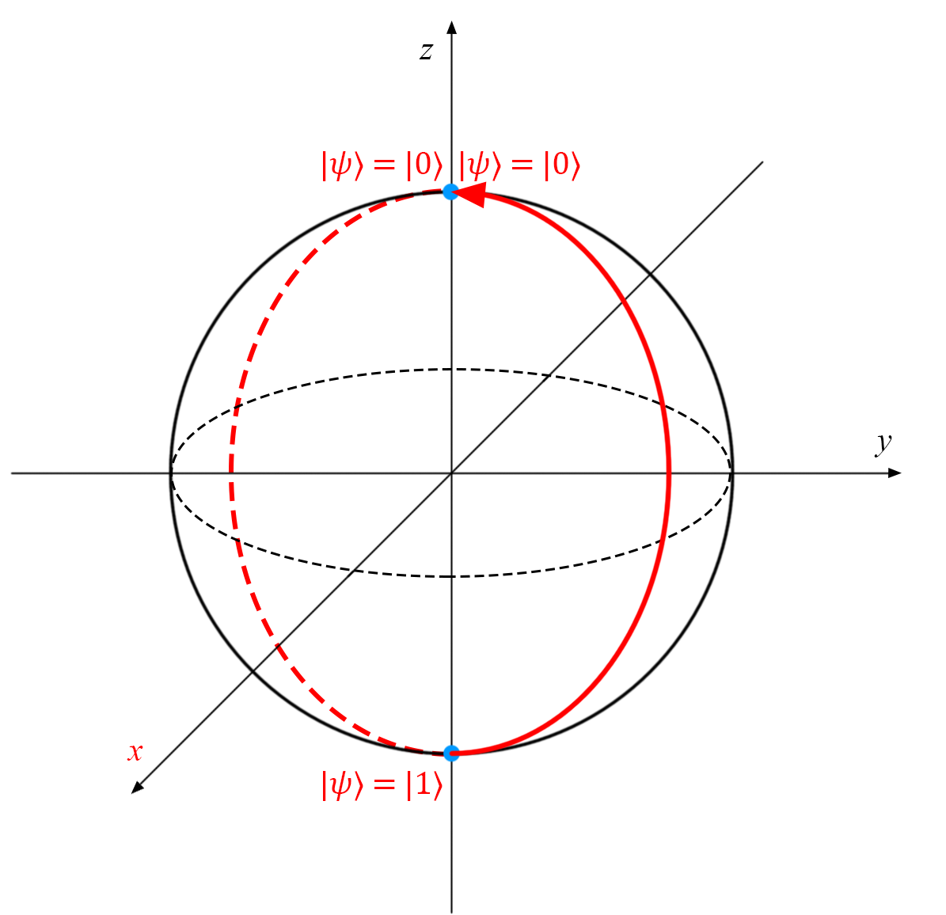
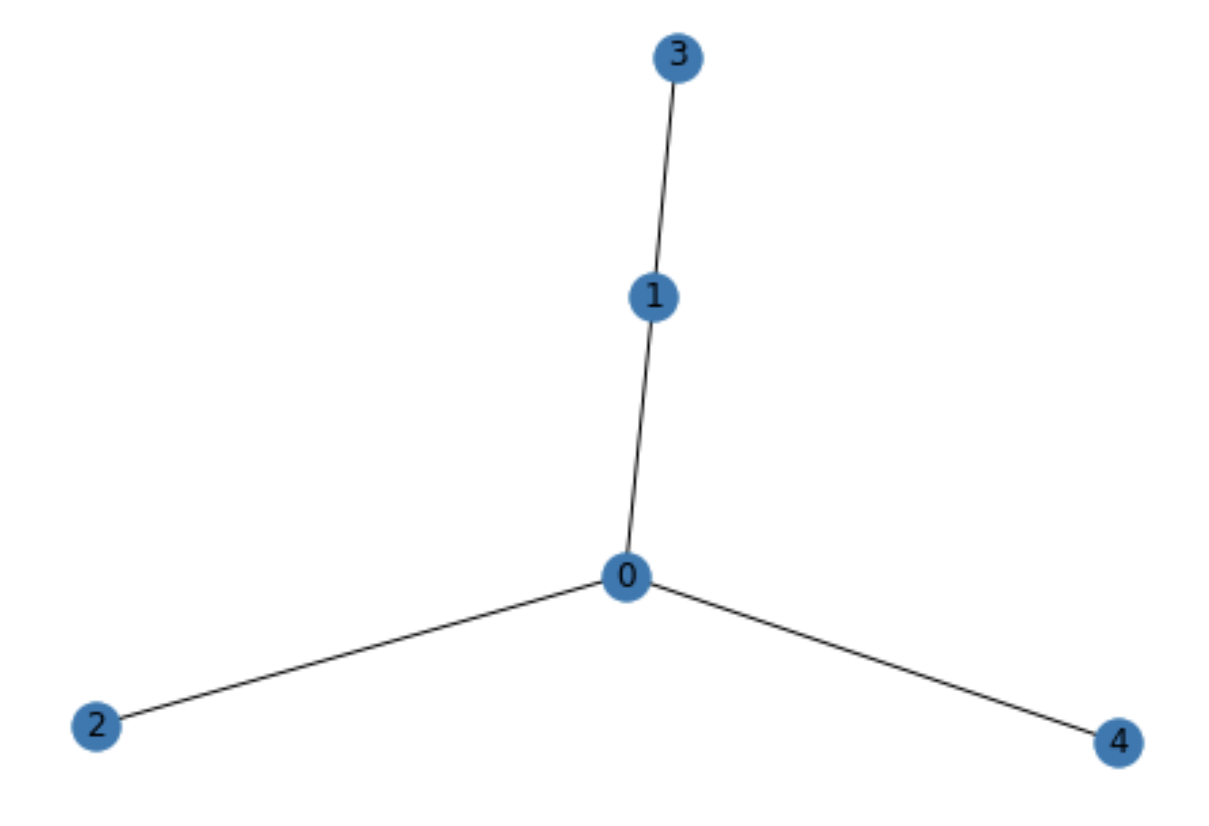
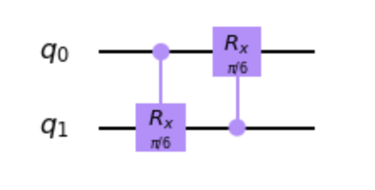
Approach
Control Rotation X (CRX) Gate behaves as transmission factor
Controlled primarily by time duration of interaction
Rotation angles around X axis are driven by time duration function
|ψ> qubit state represents state of infection within a particular individual
Probability 100% of not infected encoded as |0>
Probability 100% of being infected encoded as |1>
|+> or |-> represent individual possessing 50% probability infected
Initialized seeded(infected) individuals by applying X gate

Slide 8
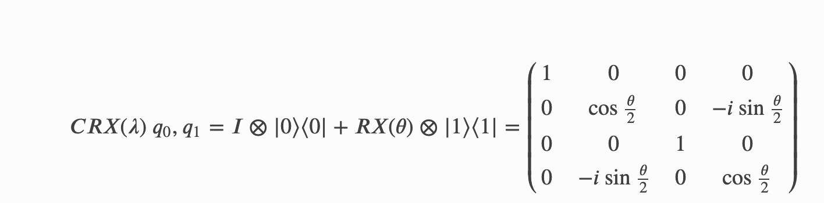
Probability
Probability amplitudes are embedded within qubit interactions
Greater rotation of theta by statistical weight of “infected” qubit results in, entangled qubit also possessing higher probability of measuring infected
Measurement done on an individual basis after “entangling process” (interactions) is over

Slide 9
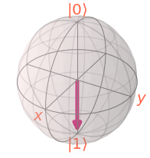
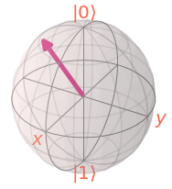
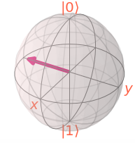
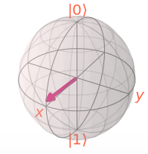
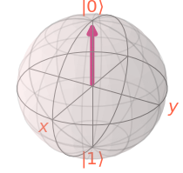
Single Infection Carrier
Theta = 0
0% Chance infected
Theta = 𝝅
100% Chance infected
Theta = 𝝅/4
25% Chance infected
Theta = 𝝅/2
50% Chance infected
Theta = 3𝝅/4
75% Chance infected

Slide 10
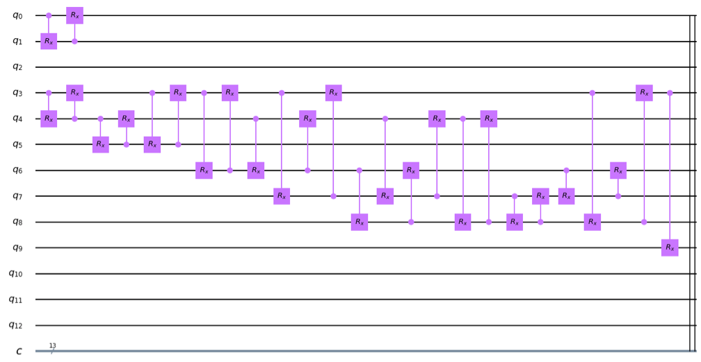
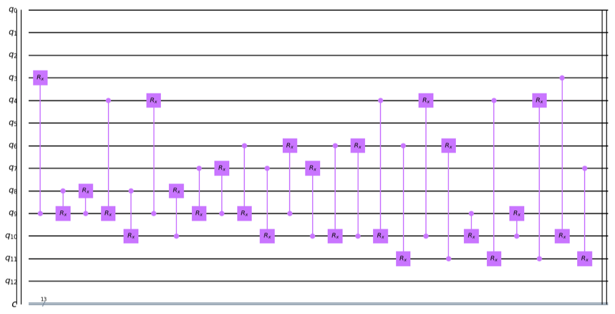
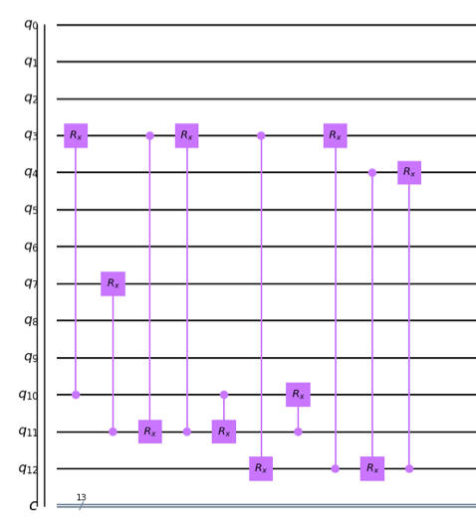
Quantum Circuit based on 2005-11-02 Network
Building the circuit with CRX Gates
Each horizontal line is 1 qubit, representing a node (possible carriers)
The purple squares and vertical lines are CRX gates, representing edges (possible spreading)

Slide 11
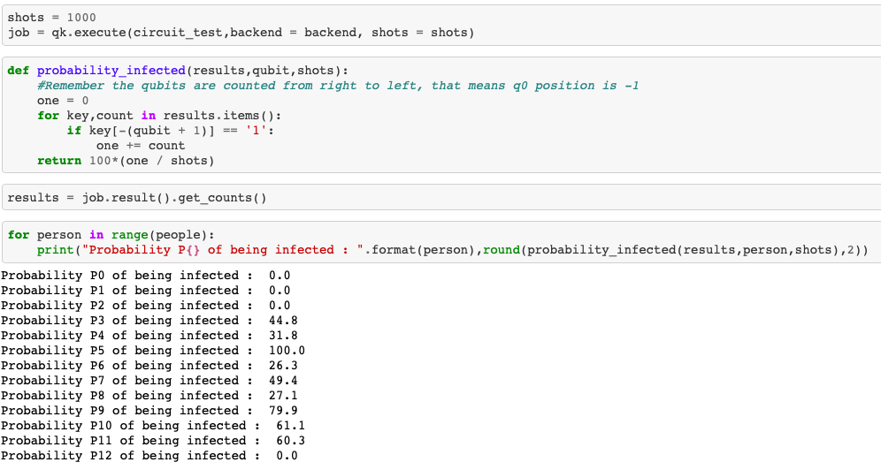
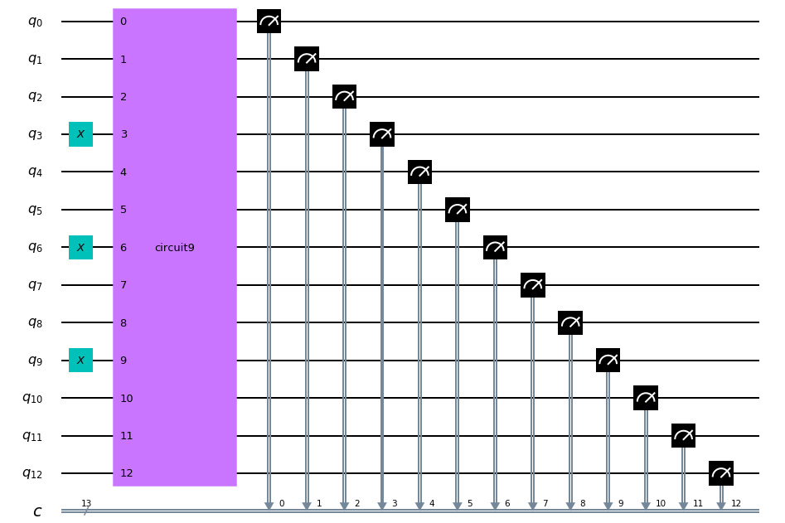
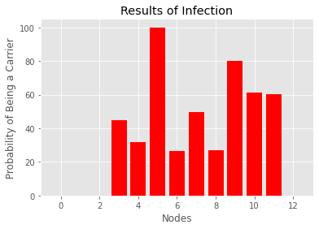
Results
Visualizing the measurement
0,1 or 2 have no interaction with infected individuals/community, so remain 100% chance uninfected
5 after interactions is now guaranteed infected, while 10 and 11 show more than 50% chance of being infected, or possibly asymptomatic carriers
3,6,9 are known carriers (initial sources of infection)

Slide 12
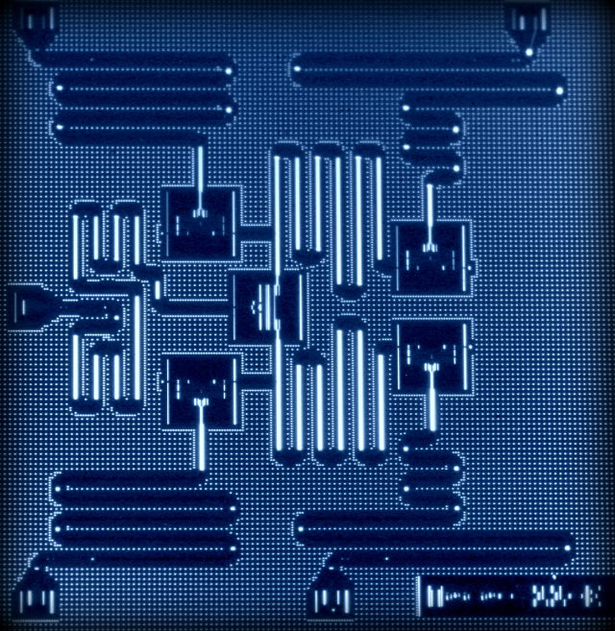
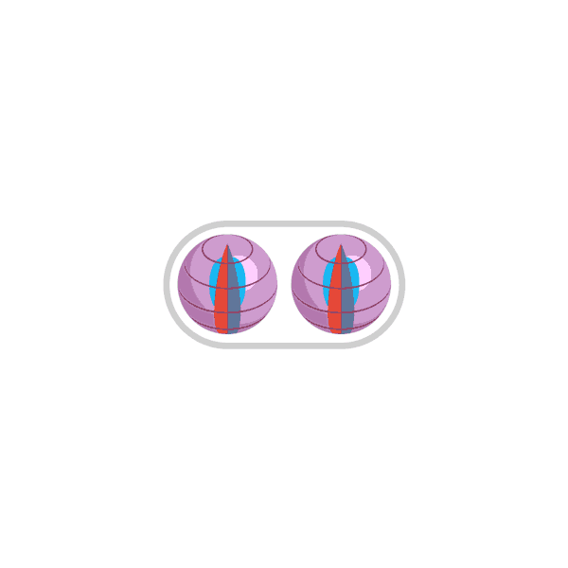
Next Steps
Scaling up to larger datasets
Applying more gates for more parameters of infection transmission
e.g. effects of lockdown intervals, self-isolation, masks, rehabilitation
Running on more powerful simulators or real quantum computers
Comparing simulated “Ground Truth” data to quantum tracer in order to judge performance
Working on real digital contact tracing data

